Slide 1


<Name>Rion Sato
<Date>December 14th, 2023

Slide 2

Outline
Executive Summary
Introduction
Methodology
Results
Conclusion
Appendix

Slide 3
Executive Summary
Summary of methodologies
The research attempts to identify the factors for a successful rocket landing. To make this determination, the following methodologies where used:
Collect data using SpaceX REST API and web scraping techniques
Wrangle data to create success/fail outcome variable
Explore data with data visualization techniques, considering the following factors: payload, launch site, flight number and yearly trend
Analyze the data with SQL, calculating the following statistics: total payload, payload range for successful launches, and total # of successful and failed outcomes
Explore launch site success rates and proximity to geographical markers
Visualize the launch sites with the most success and successful payload ranges
Build Models to predict landing outcomes using logistic regression, support vector machine (SVM), decision tree and K-nearest neighbor (KNN)
Summary of all results
Exploratory Data Analysis:
Launch success has improved over time
KSC LC-39A has the highest success rate among landing sites
Orbits ES-L1, GEO, HEO, and SSO have a 100% success rate
Visualization/Analytics:
Most launch sites are near the equator, and all are close to the coast
Predictive Analytics:
All models performed similarly on the test set. The decision tree model slightly outperformed

Slide 4
Introduction
Project background and context
SpaceX, a leader in the space industry, strives to make space travel affordable for everyone. SpaceX's accomplishments include sending spacecraft to the International Space Station, launching satellite constellations that provide Internet access, and sending manned missions into space. SpaceX is able to do this because of the relatively low cost of rocket launches ($62 million per launch) due to its novel approach of reusing the first stage of Falcon 9 rockets. Other providers that cannot reuse the first stage cost more than $165 million per launch. The launch price can be determined by determining whether the first stage will land. To do so, public data and machine learning models can be used to predict whether SpaceX, or a competing company, can reuse the first stage.
Problems
What factors contribute to a higher landing success rate for the first stage?
Things to explore to solve the above problems include:
Effect of payload mass, launch location, number of flights, and orbit on first stage landing success
Landing success rate over time
Best Prediction Model for Landing Success (Binary Classification)

Slide 5

Section 1

Slide 6
Methodology
Executive Summary
Data collection methodology
using SpaceX REST API and web scraping techniques
Perform data wrangling
by filtering the data, handling missing values and applying one hot encoding to prepare the data for analysis and modeling
Perform EDA using visualization and SQL
Perform interactive visual analytics using Folium and Plotly Dash
Perform predictive analysis using classification models
using classification models and tune and evaluate models to find best model and parameters

Slide 7
Data Collection – SpaceX API
Flowcharts
Request data
Decode response
Request information
Create dictionary
Export data
Replace missing values
Filter dataframe
Create dataframe
GitHub URL
https://github.com/Rion-Sato/My_Final_Project_of_IBM_Data_Science_Professional_Certificate/blob/main/Week1/jupyter-labs-spacex-data-collection-api.ipynb

Slide 8
Data Collection - Scraping
Flowcharts
Request data
Create BeatifulSoup object
Extract column names
Collect data
Export data
Create dataframe
Create dictionary
GitHub URL
https://github.com/Rion-Sato/My_Final_Project_of_IBM_Data_Science_Professional_Certificate/blob/main/Week1/jupyter-labs-webscraping.ipynb

Slide 9
Data Wrangling
Flowcharts
Perform EDA
Calculate
Create binary
Export data
Note(How data were processed):
When we look at Landing Outcome, we find that Landing was not always Successful and Landing Outcome has different types of outcomes.
To make these data easier to handle and understand, I converted outcomes into 1 for a successful landing and 0 for an unsuccessful landing.
GitHub URL
https://github.com/Rion-Sato/My_Final_Project_of_IBM_Data_Science_Professional_Certificate/blob/main/Week1/labs-jupyter-spacex-Data wrangling.ipynb

Slide 10
EDA with Data Visualization
Charts
Flight Number vs Payload Mass (kg) (scatter plot)
Flight Number vs Launch Site (scatter plot)
Payload Mass (kg) vs Launch Site (scatter plot)
Success Rate vs Orbit Type (bar chart)
Flight Number vs Orbit Type (scatter plot)
Payload Mass (kg) vs Orbit type (scatter plot)
Year vs Success Rate (line chart)
Analysis(The reason why I used those charts)
View relationship by using scatter plots. The variables could be useful for machine learning if a relationship exists.
Show comparisons among discrete categories with bar charts. Bar charts show the relationships among the categories and a measured value.
Line charts show changes over time.
GitHub URL
https://github.com/Rion-Sato/My_Final_Project_of_IBM_Data_Science_Professional_Certificate/blob/main/Week2/jupyter-labs-eda-dataviz.ipynb

Slide 11
EDA with SQL
Queries
Display:
Names of unique launch sites
5 records where launch site begins with ‘CCA’
Total payload mass carried by boosters launched by NASA (CRS)
Average payload mass carried by booster version F9 v1.1.
List:
Date of first successful landing on ground pad
Names of boosters which had success landing on drone ship and have payload mass greater than 4,000 but less than 6,000
Total number of successful and failed missions
Names of booster versions which have carried the max payload
Failed landing outcomes on drone ship, their booster version and launch site for the months in the year 2015
Count of landing outcomes between 2010-06-04 and 2017-03-20 (desc)
GitHub URL
https://github.com/Rion-Sato/My_Final_Project_of_IBM_Data_Science_Professional_Certificate/blob/main/Week2/jupyter-labs-eda-sql-coursera_sqllite.ipynb

Slide 12
Build an Interactive Map with Folium
Markers Indicating Launch Sites
Added blue circle at NASA Johnson Space Center's coordinate with a popup label showing its name using its latitude and longitude coordinates
Added red circles at all launch sites coordinates with a popup label showing its name using its name using its latitude and longitude coordinates
Colored Markers of Launch Outcomes
• Added colored markers of successful (green) and unsuccessful (red) launches at each launch site to show which launch sites have high success Rates
Distances Between a Launch Site to Proximities
• Added colored lines to show distance between launch site CCAFS SLC- 40 and its proximity to the nearest coastline, railway, highway, and city
GitHub URL
https://github.com/Rion-Sato/My_Final_Project_of_IBM_Data_Science_Professional_Certificate/blob/main/Week3/lab_jupyter_launch_site_location.ipynb

Slide 13
Build a Dashboard with Plotly Dash
Dropdown List with Launch Sites
Allow user to select all launch sites or a certain launch site Slider of Payload Mass Range
Allow user to select payload mass range
Pie Chart Showing Successful Launches
Allow user to see successful and unsuccessful launches as a percent of the total
Scatter Chart Showing Payload Mass vs. Success Rate by Booster Version
Allow user to see the correlation between Payload and Launch Success
GitHub URL
https://github.com/Rion-Sato/My_Final_Project_of_IBM_Data_Science_Professional_Certificate/blob/main/Week3/spacex_dash_app.py

Slide 14
Predictive Analysis (Classification)
Flowcharts&explain
Create
Standardize
Split
Create
NumPy array
from the Class column
the data with StandardScaler.
Fit and transform the data.
the data
using train_test_split
a GridSearchCV object with cv=10 for parameter optimization
Identify
Assess
Calculate
Apply
the best model
using Accuracy
the confusion matrix for all models
accuracy on the test data using .score() for all models
GridSearchCV on different algorithms:
logistic regression,
support vector machine,
decision tree,
K-Nearest Neighbor
GitHub URL
https://github.com/Rion-Sato/My_Final_Project_of_IBM_Data_Science_Professional_Certificate/blob/main/Week4
/SpaceX_Machine_Learning_Prediction_Part_5.jupyterlite.ipynb

Slide 15
Results
Exploratory Data Analysis
Launch success has improved over time
KSC LC-39A has the highest success rate among landing sites
Orbits ES-L1, GEO, HEO and SSO have a 100% success rate
Visual Analytics
Most launch sites are near the equator, and all are close to the coast
Launch sites are far enough away from anything a failed launch can damage (city, highway, railway), while still close enough to bring people and material to support launch activities
Predictive Analytics
Decision Tree model is the best predictive model for the dataset

Slide 16

Section 2

Slide 17
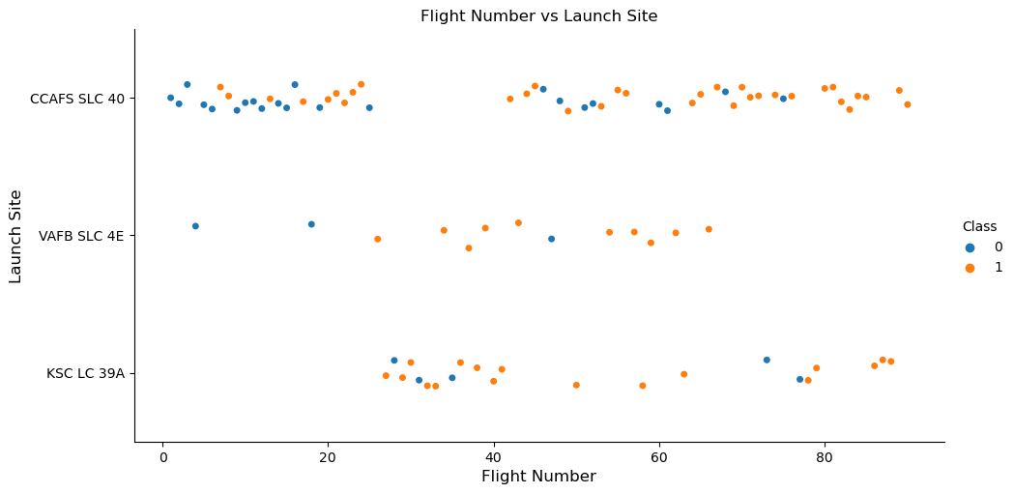
Flight Number vs. Launch Site
Earlier flights had a lower success rate (blue = fail)
Later flights had a higher success rate (orange = success)
Around half of launches were from CCAFS SLC 40 launch site
VAFB SLC 4E and KSC LC 39A have higher success rates
We can infer that new launches have a higher success rate

Slide 18
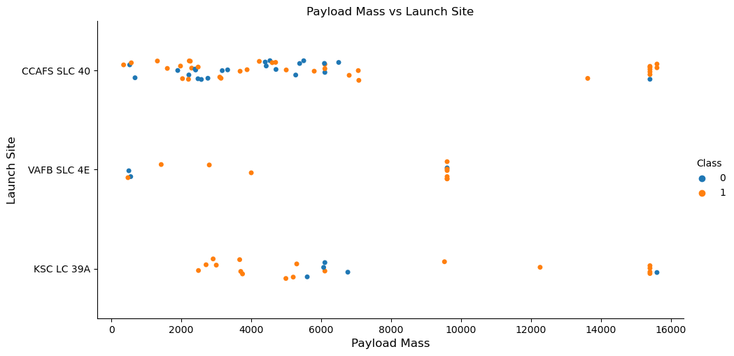
Payload vs. Launch Site
Typically, the higher the payload mass (kg), the higher the success rate
Most launces with a payload greater than 7,000 kg were successful
KSC LC 39A has a 100% success rate for launches less than 5,500 kg
VAFB SKC 4E has not launched anything greater than ~10,000 kg

Slide 19
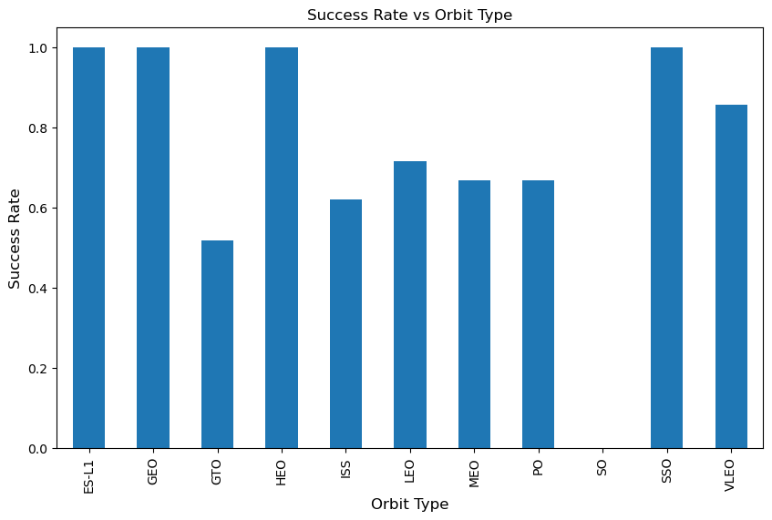
Success Rate vs. Orbit Type
100% Success Rate: ES-L1, GEO, HEO and SSO
50%-80% Success Rate: GTO, ISS, LEO, MEO, PO
0% Success Rate: SO

Slide 20
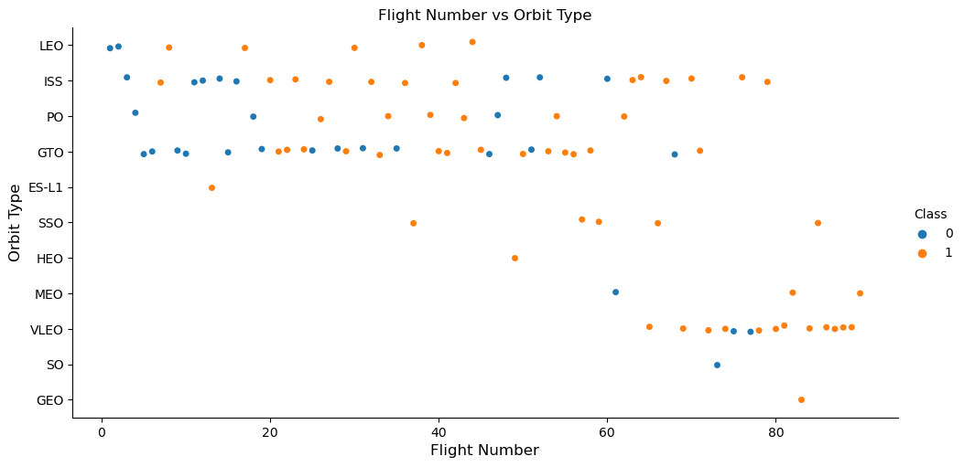
Flight Number vs. Orbit Type
The success rate typically increases with the number of flights for each orbit
This relationship is highly apparent for the LEO orbit
The GTO orbit, however, does not follow this trend

Slide 21
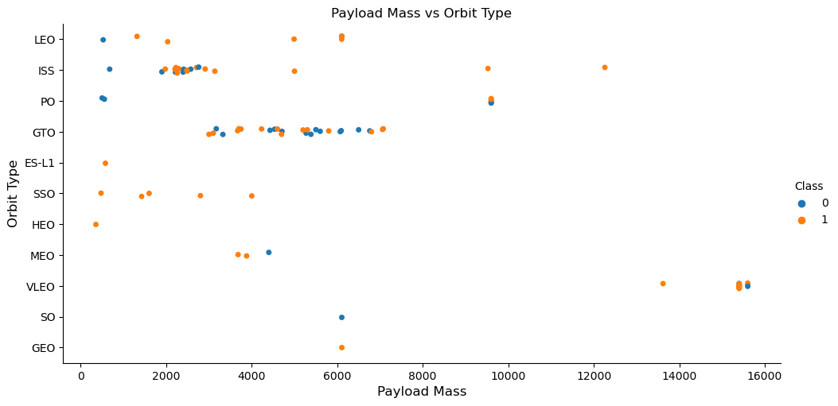
Payload vs. Orbit Type
Heavy payloads are better with LEO, ISS and PO orbits
The GTO orbit has mixed success with heavier payloads

Slide 22
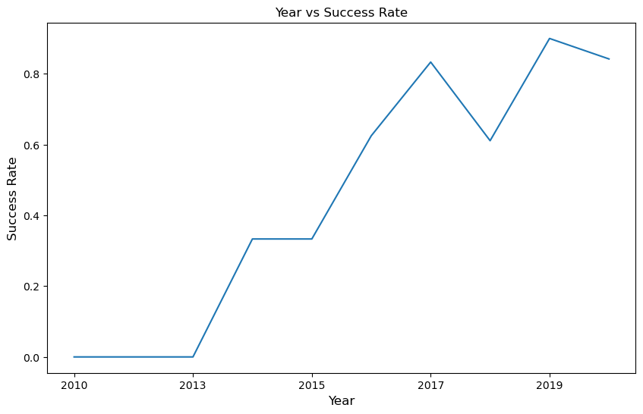
Launch Success Yearly Trend
The success rate improved from 2013-2017 and 2018-2019
The success rate decreased from 2017-2018 and from 2019-2020
Overall, the success rate has improved since 2013

Slide 23
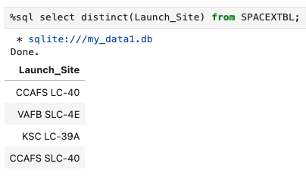
All Launch Site Names
Launch Site Names
CCAFS LC-40
CCAFS SLC-40
KSC LC-39A
VAFB SLC-4E

Slide 24
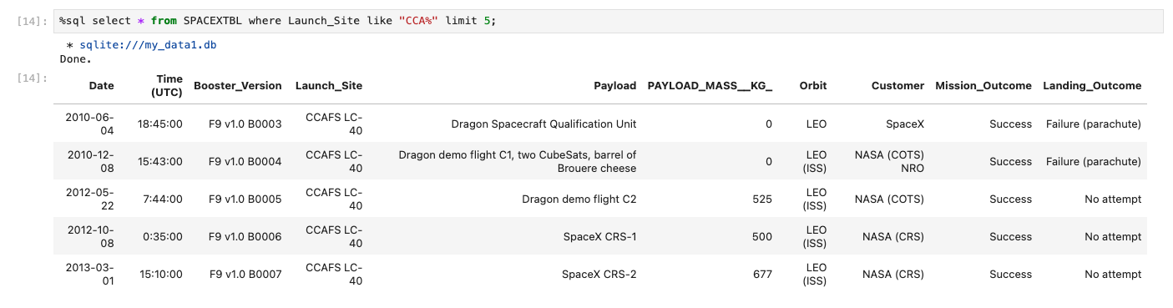
Launch Site Names Begin with 'CCA'
Records with Launch Site Starting with CCA
Displaying 5 records below

Slide 25
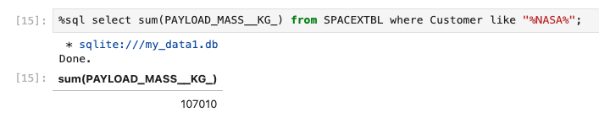
Total Payload Mass
Total Payload Mass
107,010 kg (total) carried by boosters launched by NASA

Slide 26
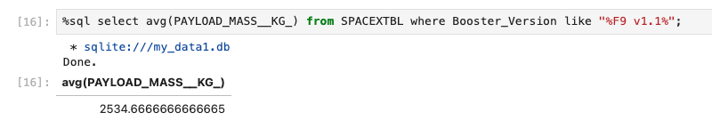
Average Payload Mass by F9 v1.1
Average Payload Mass
2,534 kg (average) carried by booster version F9 v1.1

Slide 27
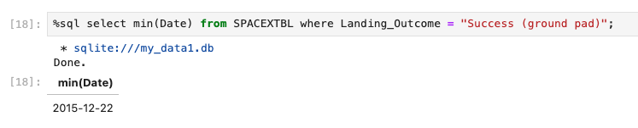
First Successful Ground Landing Date
1st Successful Landing in Ground Pad
12/22/2015

Slide 28
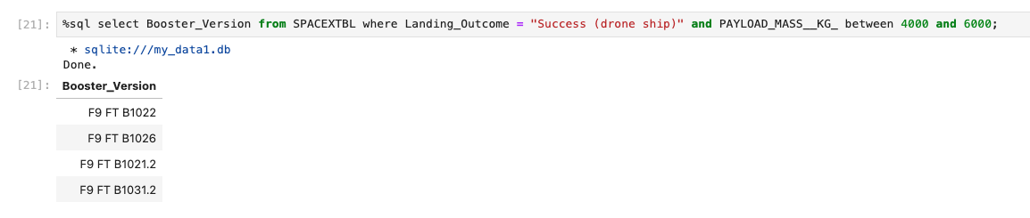
Successful Drone Ship Landing with Payload between 4000 and 6000
Booster Drone Ship Landing
Booster mass greater than 4,000 but less than 6,000:
JSCAT-14, JSCAT-16, SES-10, SES-11 / EchoStar 105

Slide 29
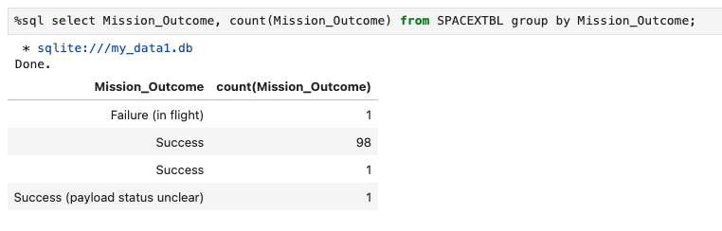
Total Number of Successful and Failure Mission Outcomes
Total Number of Successful and Failed Mission Outcomes
1 Failure in Flight
99 Success
1 Success (payload status unclear)

Slide 30
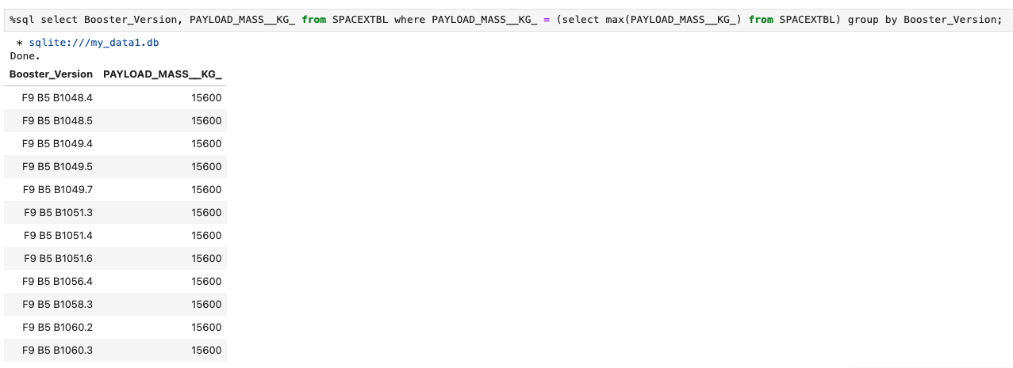
Boosters Carried Maximum Payload
Carrying Max Payload
F9 B5 B1048.4
F9 B5 B1049.4
F9 B5 B1051.3
F9 B5 B1056.4
F9 B5 B1048.5
F9 B5 B1051.4
F9 B5 B1049.5
F9 B5 B1060.2
F9 B5 B1058.3
F9 B5 B1051.6
F9 B5 B1060.3
F9 B5 B1049.7

Slide 31
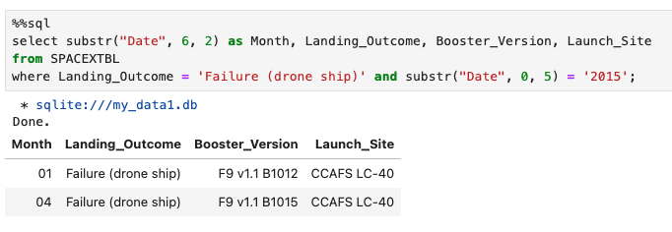
2015 Launch Records
In 2015
Showing month, date, booster version, launch site and landing outcome

Slide 32
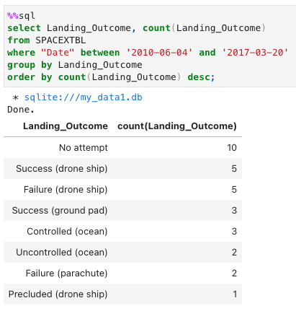
Rank Landing Outcomes Between 2010-06-04 and 2017-03-20
Ranked Descending
Count of landing outcomes between 2010-06-04 and 2017-03-20 in descending order

Slide 33

Section 3

Slide 34
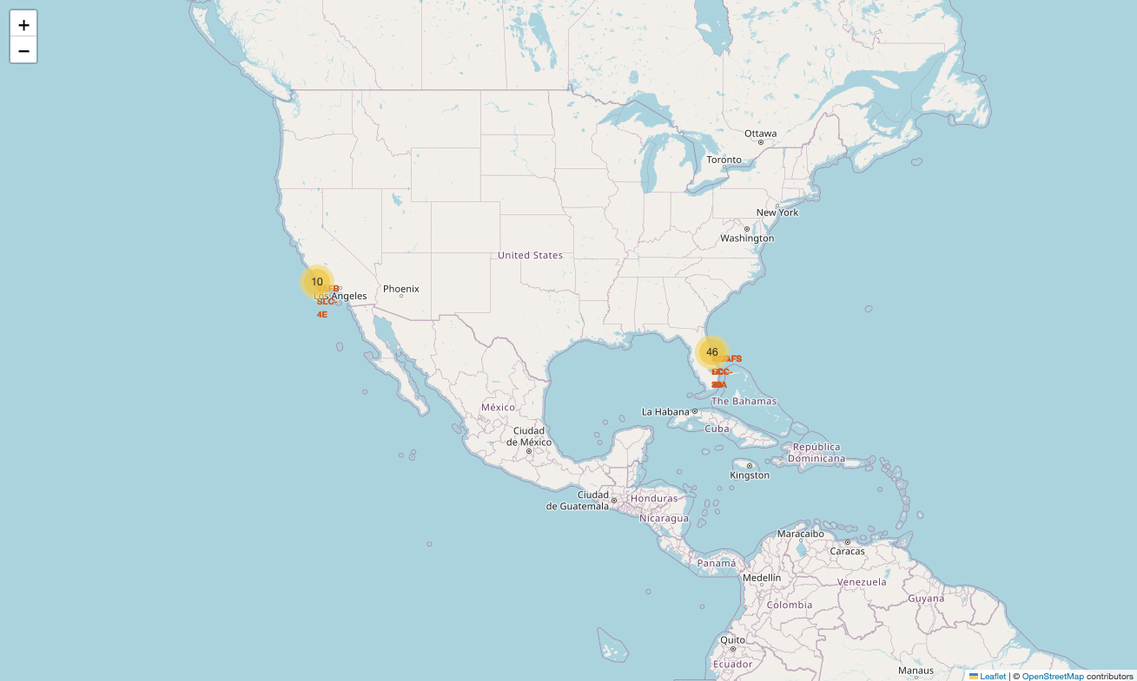
Launch Sites
With Markers
Near Equator: the closer the launch site to the equator, the easier it is to launch to equatorial orbit, and the more help you get from Earth's rotation for a prograde orbit. Rockets launched from sites near the equator get an additional natural boost due to the rotational speed of earth that helps save the cost of putting in extra fuel and boosters.

Slide 35
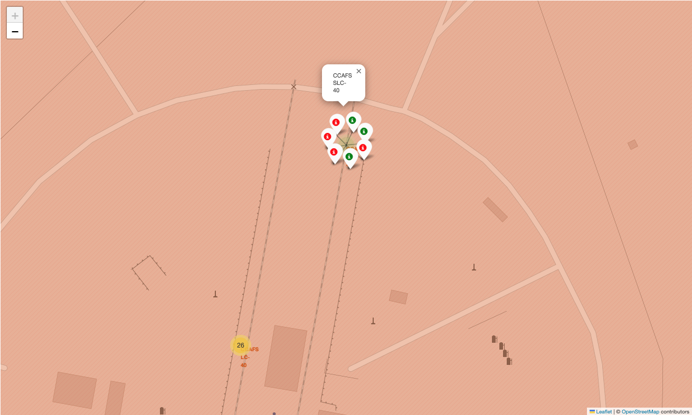
Launch Outcomes
At Each Launch Site
Outcomes:
Green markers for successful launches
Red markers for unsuccessful launches
Launch site CCAFS SLC-40 has a 3/7 success rate (42.9%)

Slide 36
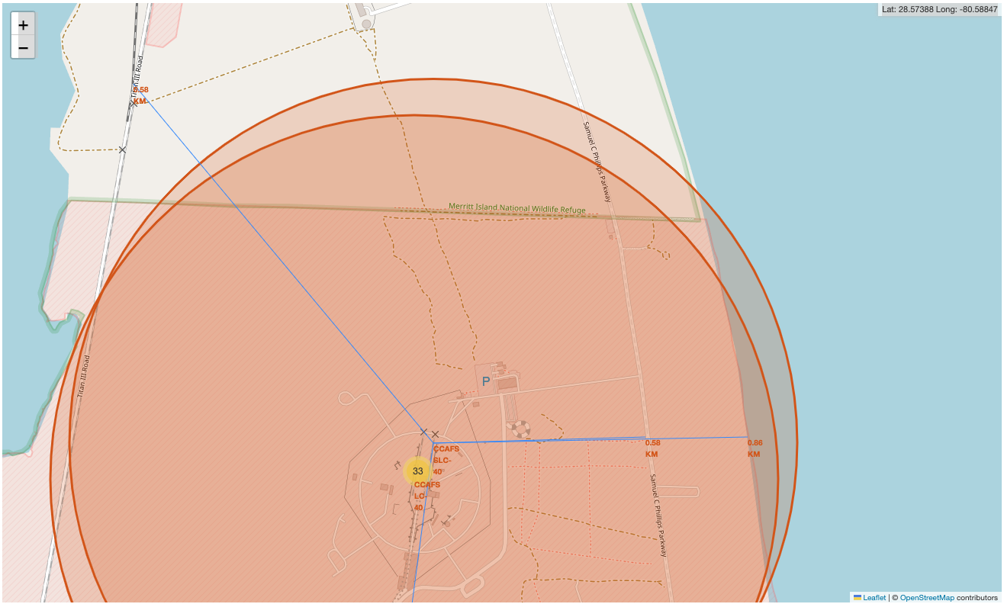
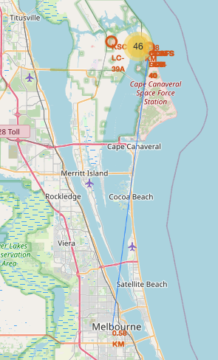
Distance from CCAFS SLC-40 (one of the Launch Sites)
CCAFS SLC-40
0.86 km from nearest coastline
0.58km from nearest railway
0.58 km from nearest city
0.58 km from nearest highway
coastline, railway, highway
city

Slide 37

Section 4

Slide 38
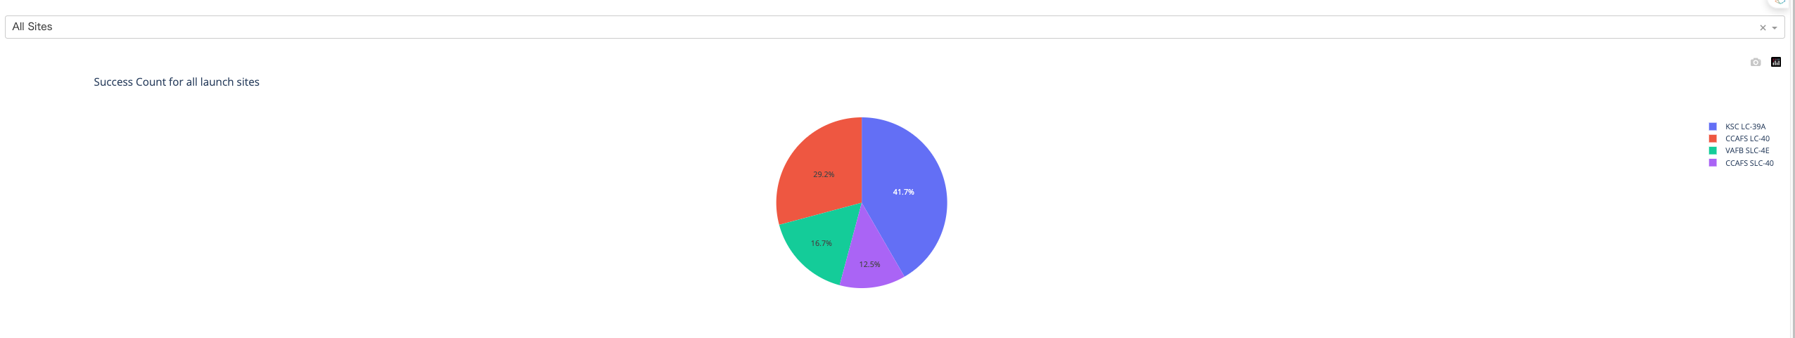
Launch Success by Site
Success as Percent of Total
KSC LC-39A has the most successful launches amongst launch sites (41.2%)

Slide 39
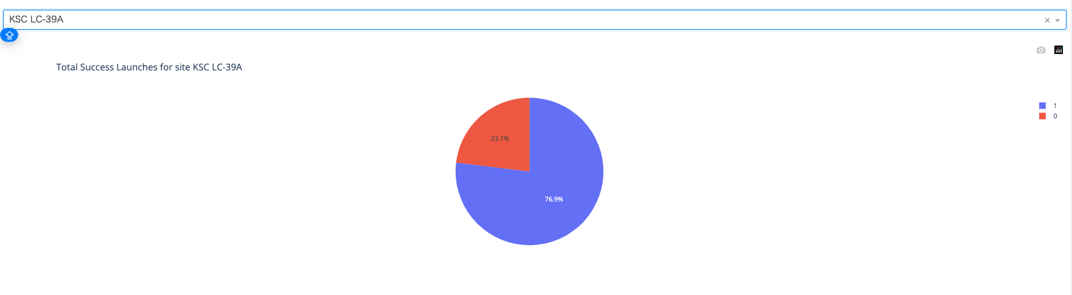
Launch Success (KSC LC-39A)
Success as Percent of Total
KSC LC-39A has the highest success rate amongst launch sites (76.9%)

Slide 40
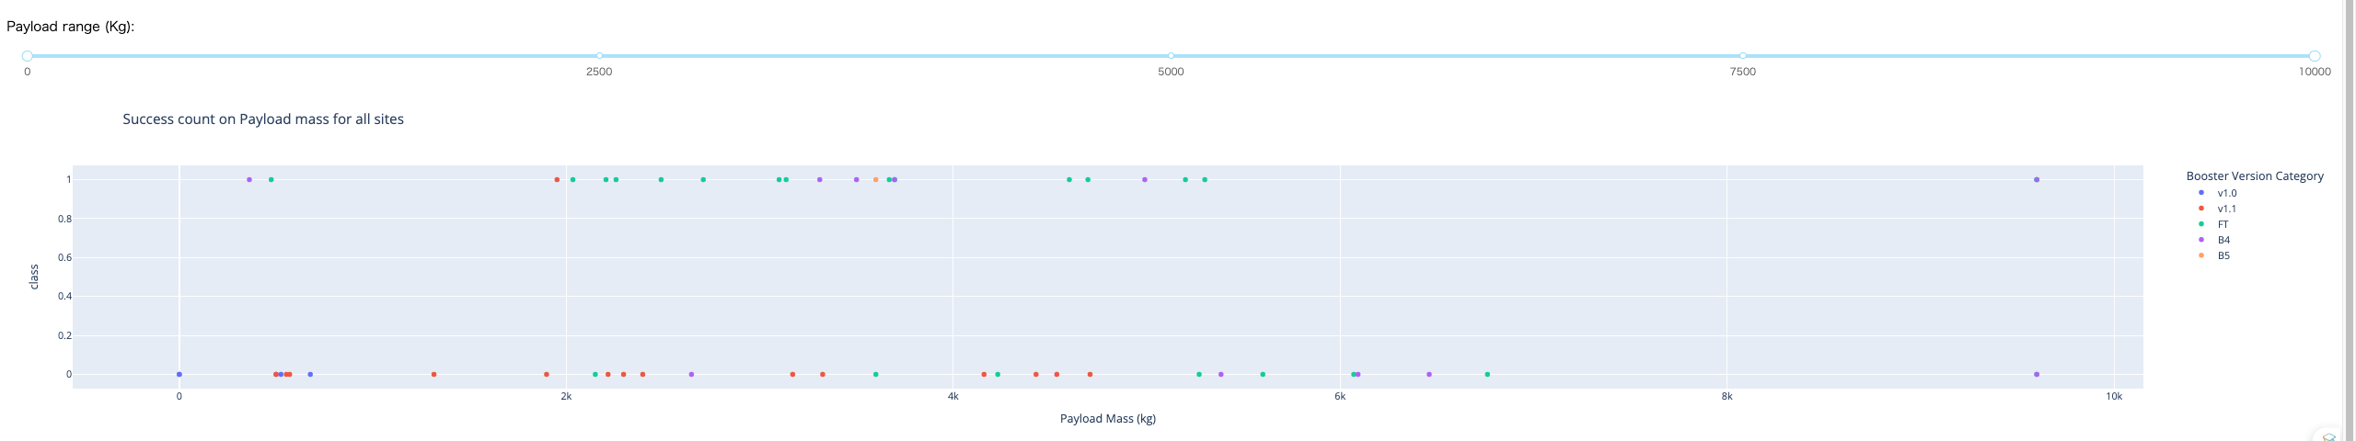
Payload Mass and Success
By Booster Version
Payloads between 4,000 kg and 6,000 kg have the highest success rate
Payloads of more than 6000 kg almost failed

Slide 41

Section 5

Slide 42
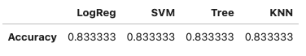
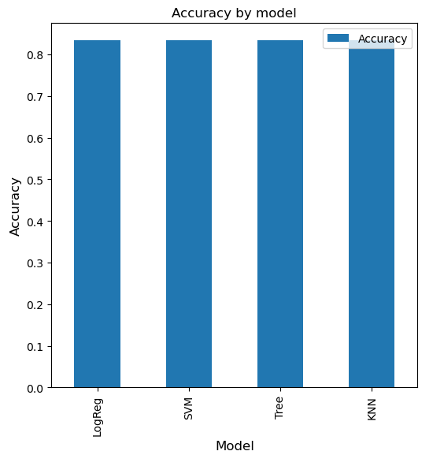
Classification Accuracy
Accuracy table
Accuracy
All the models performed at about the same level and had the same accuracy.
Accuracy bar chart

Slide 43
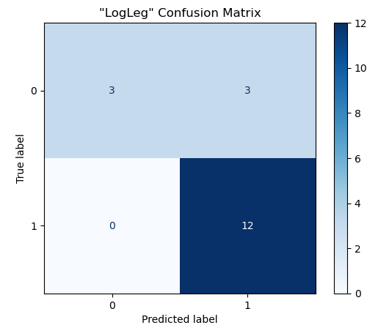
Confusion Matrix
Performance Summary
A confusion matrix summarizes the performance of a classification algorithm
All the confusion matrices were identical
The fact that there are false positives (Type 1 error) is not good
Confusion Matrix Outputs:
12 True positive
3 True negative
3 False positive
0 False Negative
Confusion Matrix (ex. LogReg)

Slide 44
Conclusions
Research
Model Performance: The models performed similarly on the test set with the decision tree model slightly outperforming
Equator: Most of the launch sites are near the equator for an additional natural boost due to the rotational speed of earth which helps save the cost of putting in extra fuel and boosters
Coast: All the launch sites are close to the coast
Launch Success: Increases over time
KSC LC-39A: Has the highest success rate among launch sites. Has a 100% success rate for launches less than 5,500 kg
Orbits: ES-L1, GEO, HEO, and SSO have a 100% success rate
Payload Mass: Across all launch sites, the higher the payload mass (kg), the higher the success rate

Slide 45
Appendix
My GitHub repository for this course:
https://github.com/Rion-Sato/My_Final_Project_of_IBM_Data_Science_Professional_Certificate

Slide 46


